Slide 1
Dynamic Memory Allocation

Slide 2
Static Memory
All memory allocation so far has been static or automatic
Don’t have to worry finding and releasing memory
The compiler did this for you
Easy and effortless, however…

Slide 3
Static Memory Cont.
Static memory allocation has limits
Size must be known at compile time, can’t be changed
Stack (static) size is much smaller than heap (dynamic) size
Stack: 1 – 2 MB in size
Heap is the rest of memory (GBs or more)
Static variables exist for the lifetime of the program, whether needed or not

Slide 4
Dynamic Memory
Dynamic memory allocation is under complete control of you, the programmer
You must find and release the memory
Bad memory management will cause crashes (or worse)

Slide 5
Dynamic Memory
However, dynamic memory is what makes C/C++ so powerful
This is the fundamental difference between C/C++ and other languages such as Java, C#, Python, and many more
Also what makes other languages easier to learn and use

Slide 6
How Allocate and Deallocate
Two primary functions required for dynamic memory management:
malloc – allocates a block of memory
free – deallocates a block of memory
Need to #include <stdlib.h>

Slide 7
Using malloc
The prototype for malloc is
Returns a void pointer to the start of the memory

Slide 8
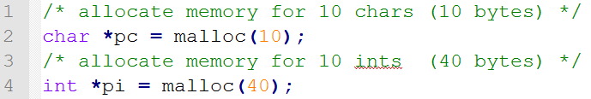
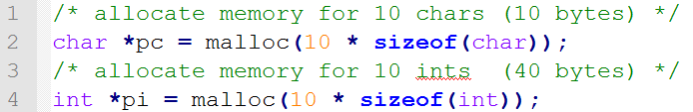
Using malloc Cont.
Argument sent to malloc is number of bytes to allocate
Size of types may change, so it’s best to use sizeof() instead

Slide 9
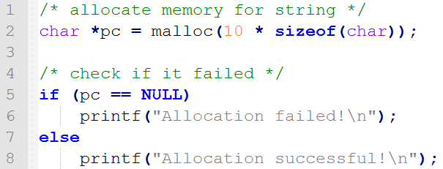
Using malloc Cont.
Allocating memory can fail
malloc will return NULL when this happens
You should always check for this

Slide 10
calloc
Allocated memory is uninitialized
Can initialize the memory to all 0’s using calloc
calloc has two parameters: number of elements and size of those elements

Slide 11
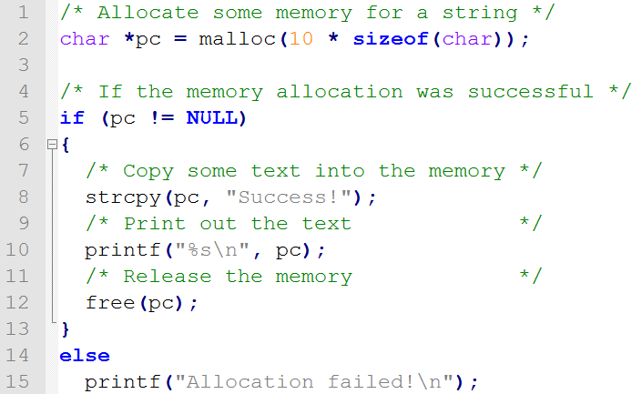
Using free
Need to release the memory once we’re done
Simply need to call free

Slide 12
Common Errors
Undefined behavior may occur if you attempt to:
Use memory that’s already been freed (dangling pointer)
Free memory before allocating it (wild pointer)
Call free twice (“double free”)
Forget to call free (causes memory leaks, which are very bad)
Call free on a pointer not pointing to the beginning of the allocated memory

Slide 13
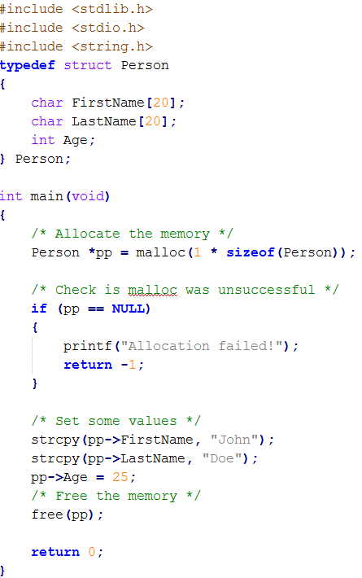
Allocating struct example

Slide 14
Summary
Use malloc (or calloc) to allocate dynamic memory
Remember to check for failure!
Use free to deallocate memory

Slide 15
Questions?

